Slide 1
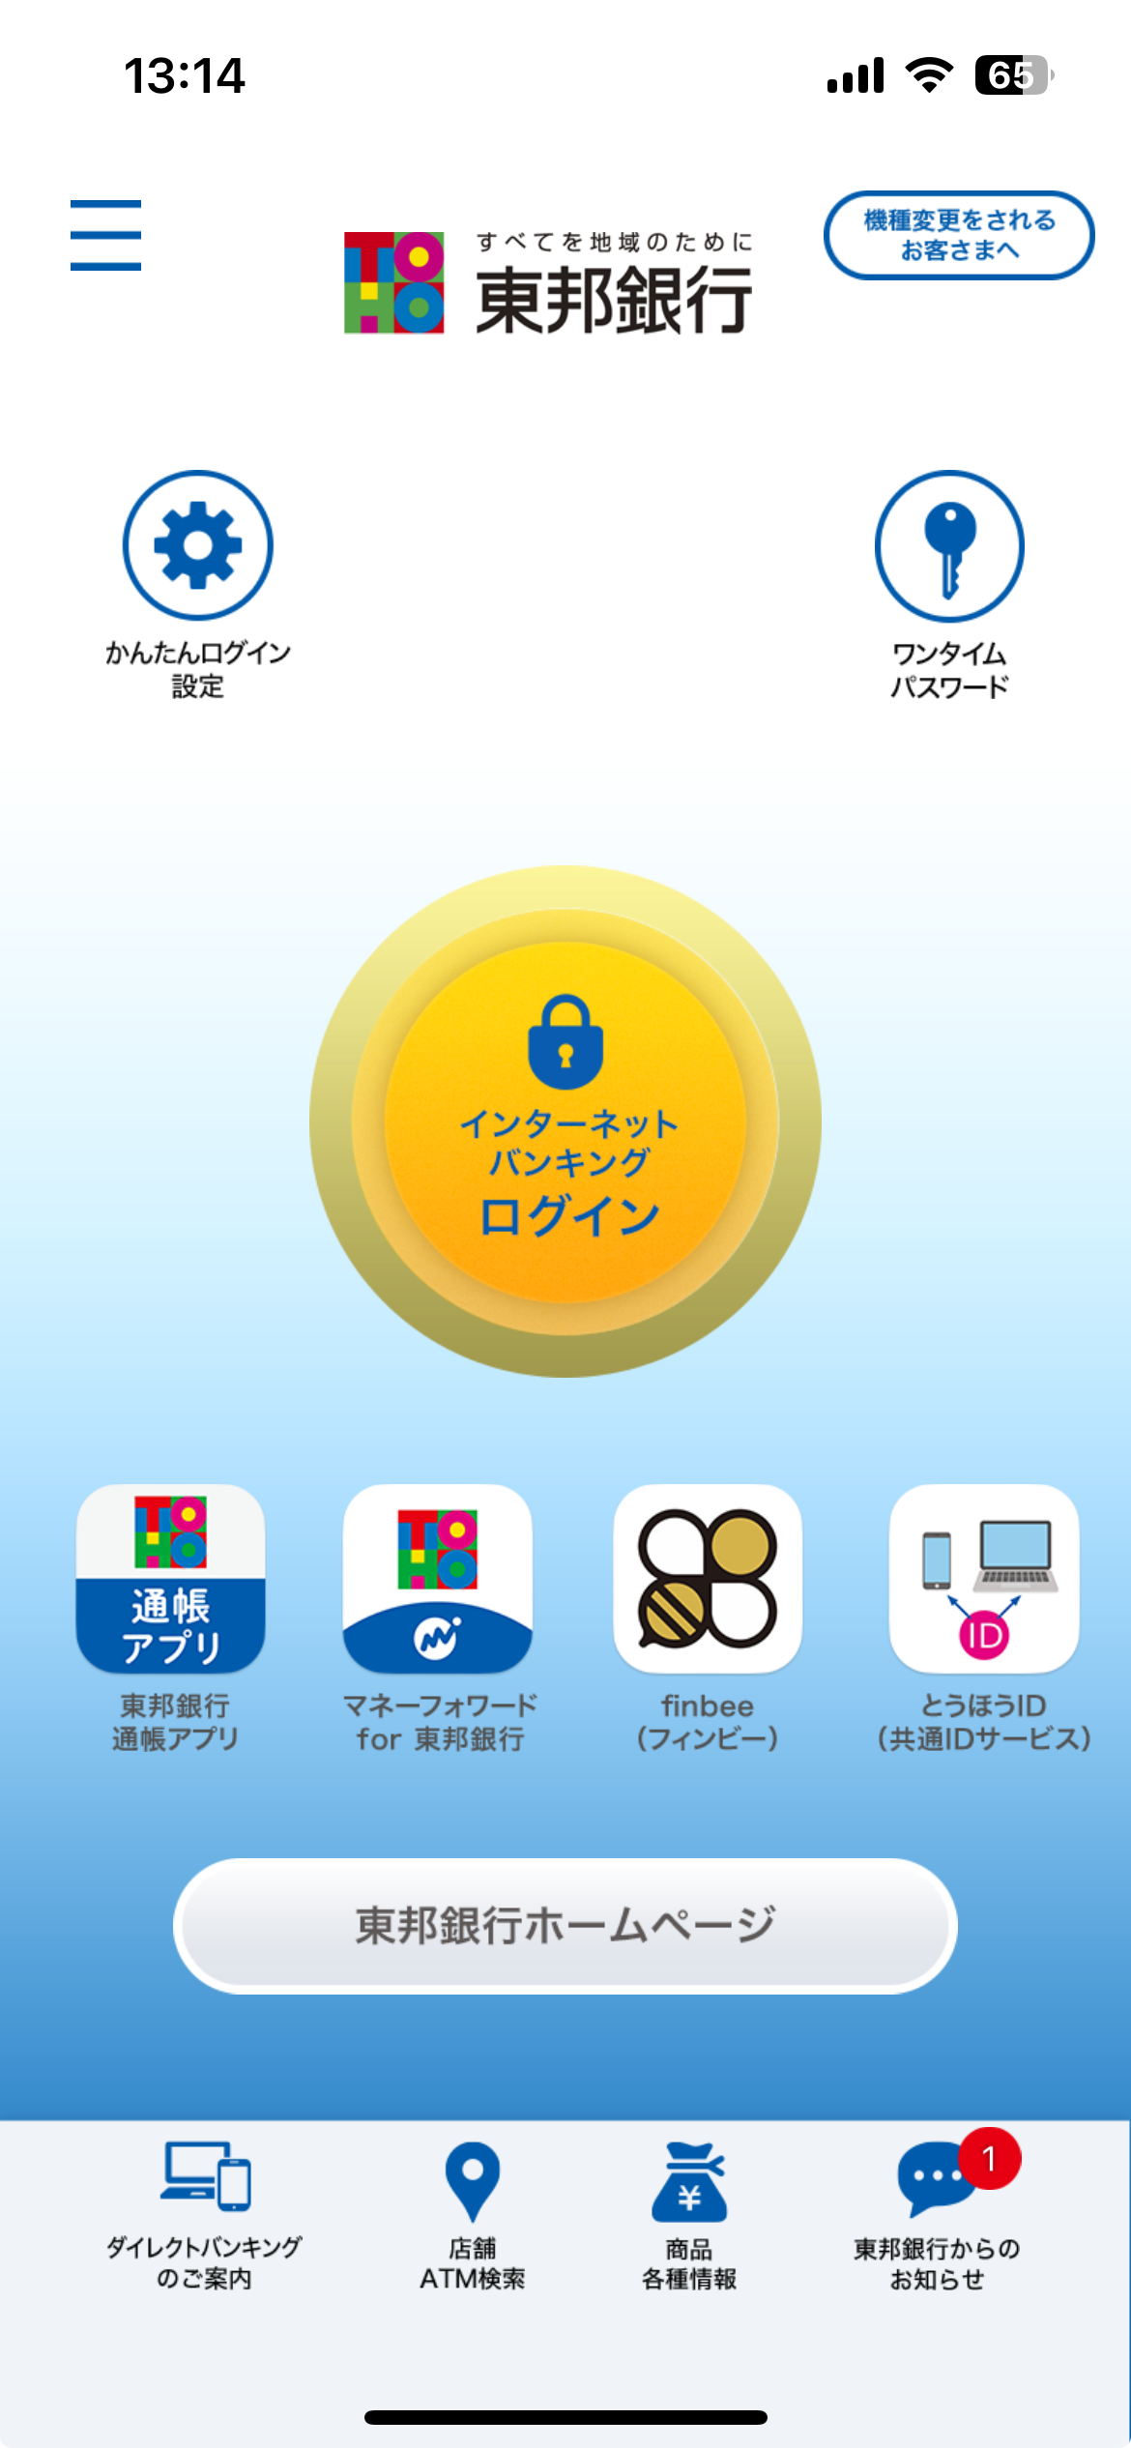
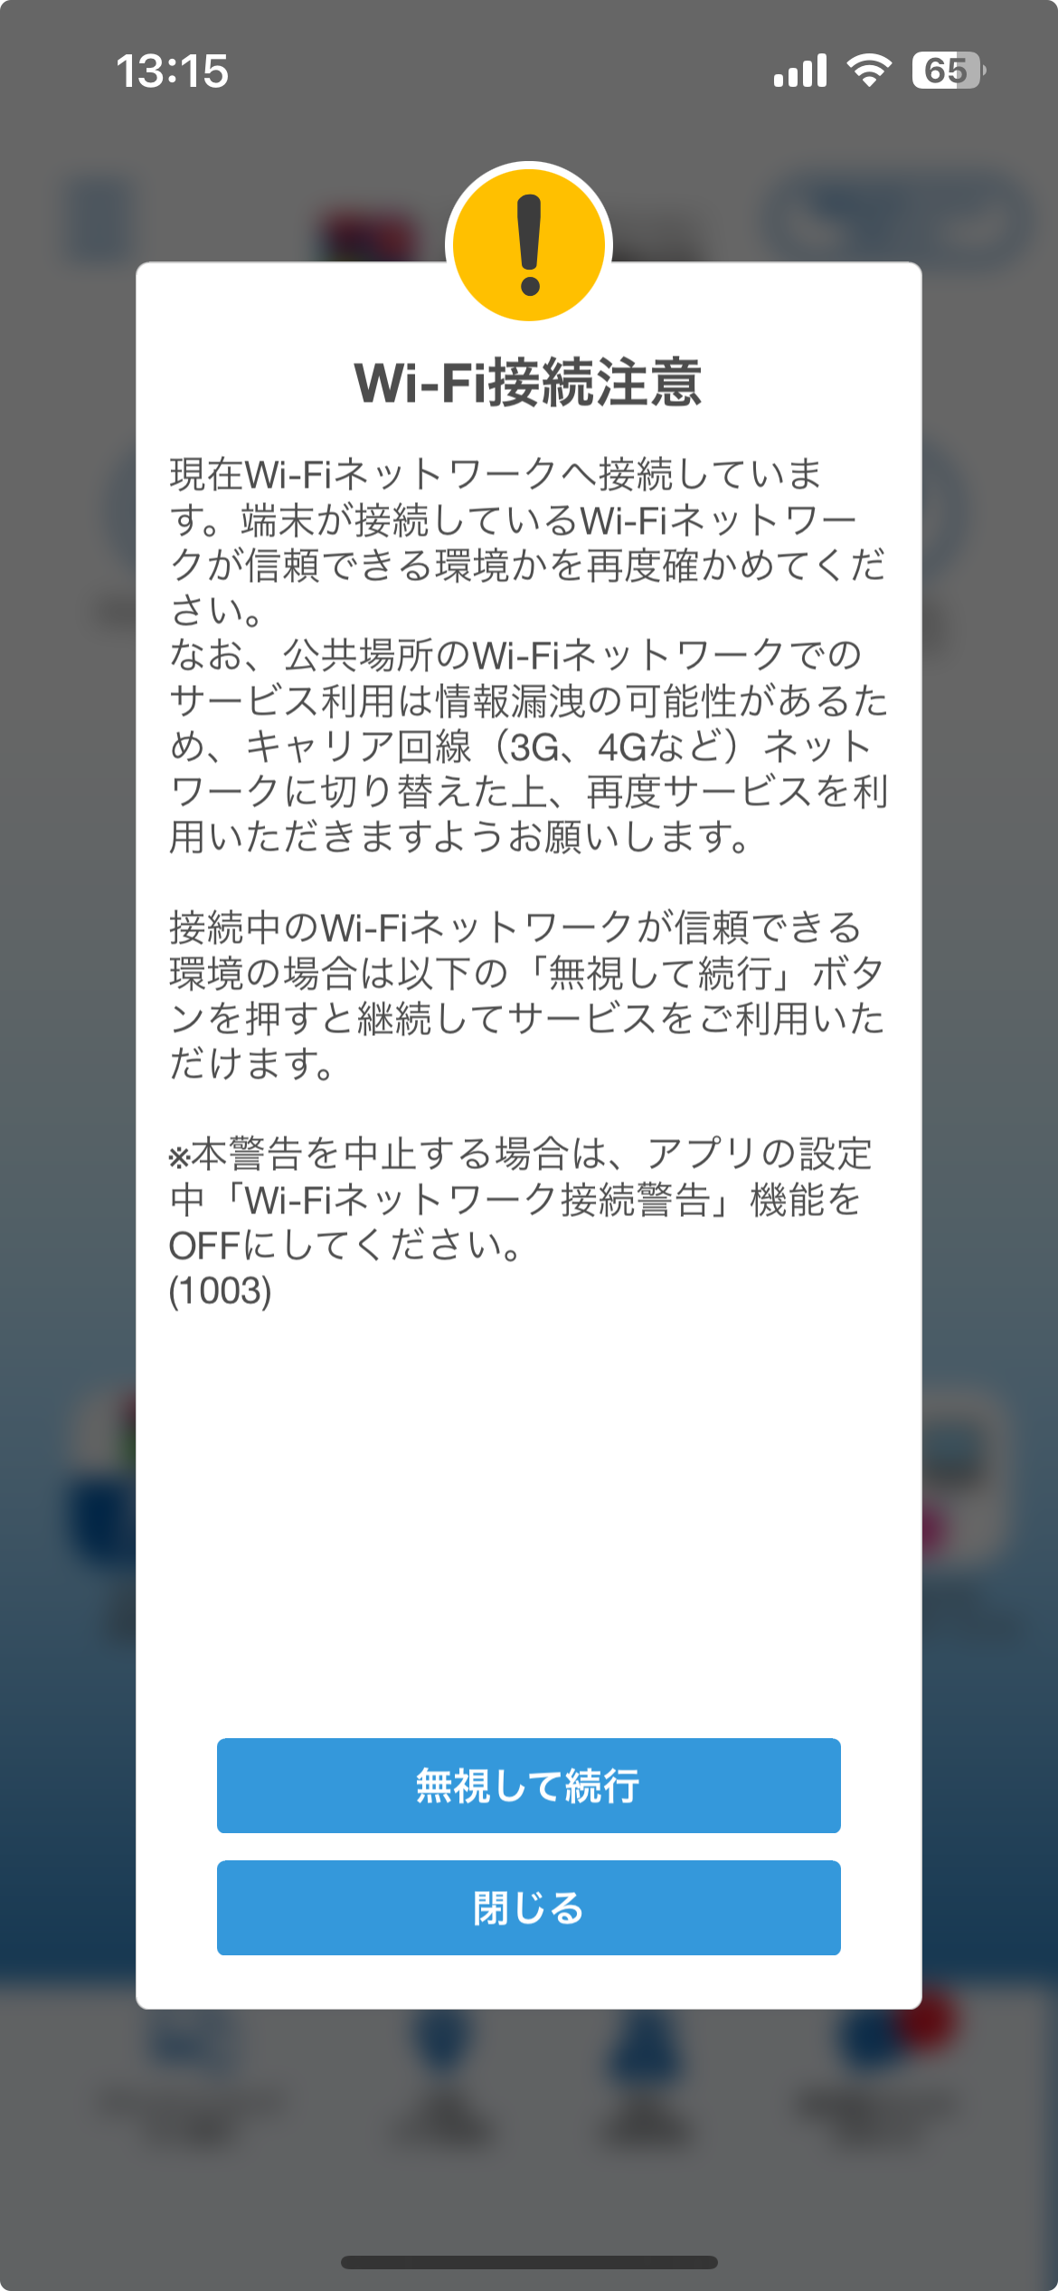
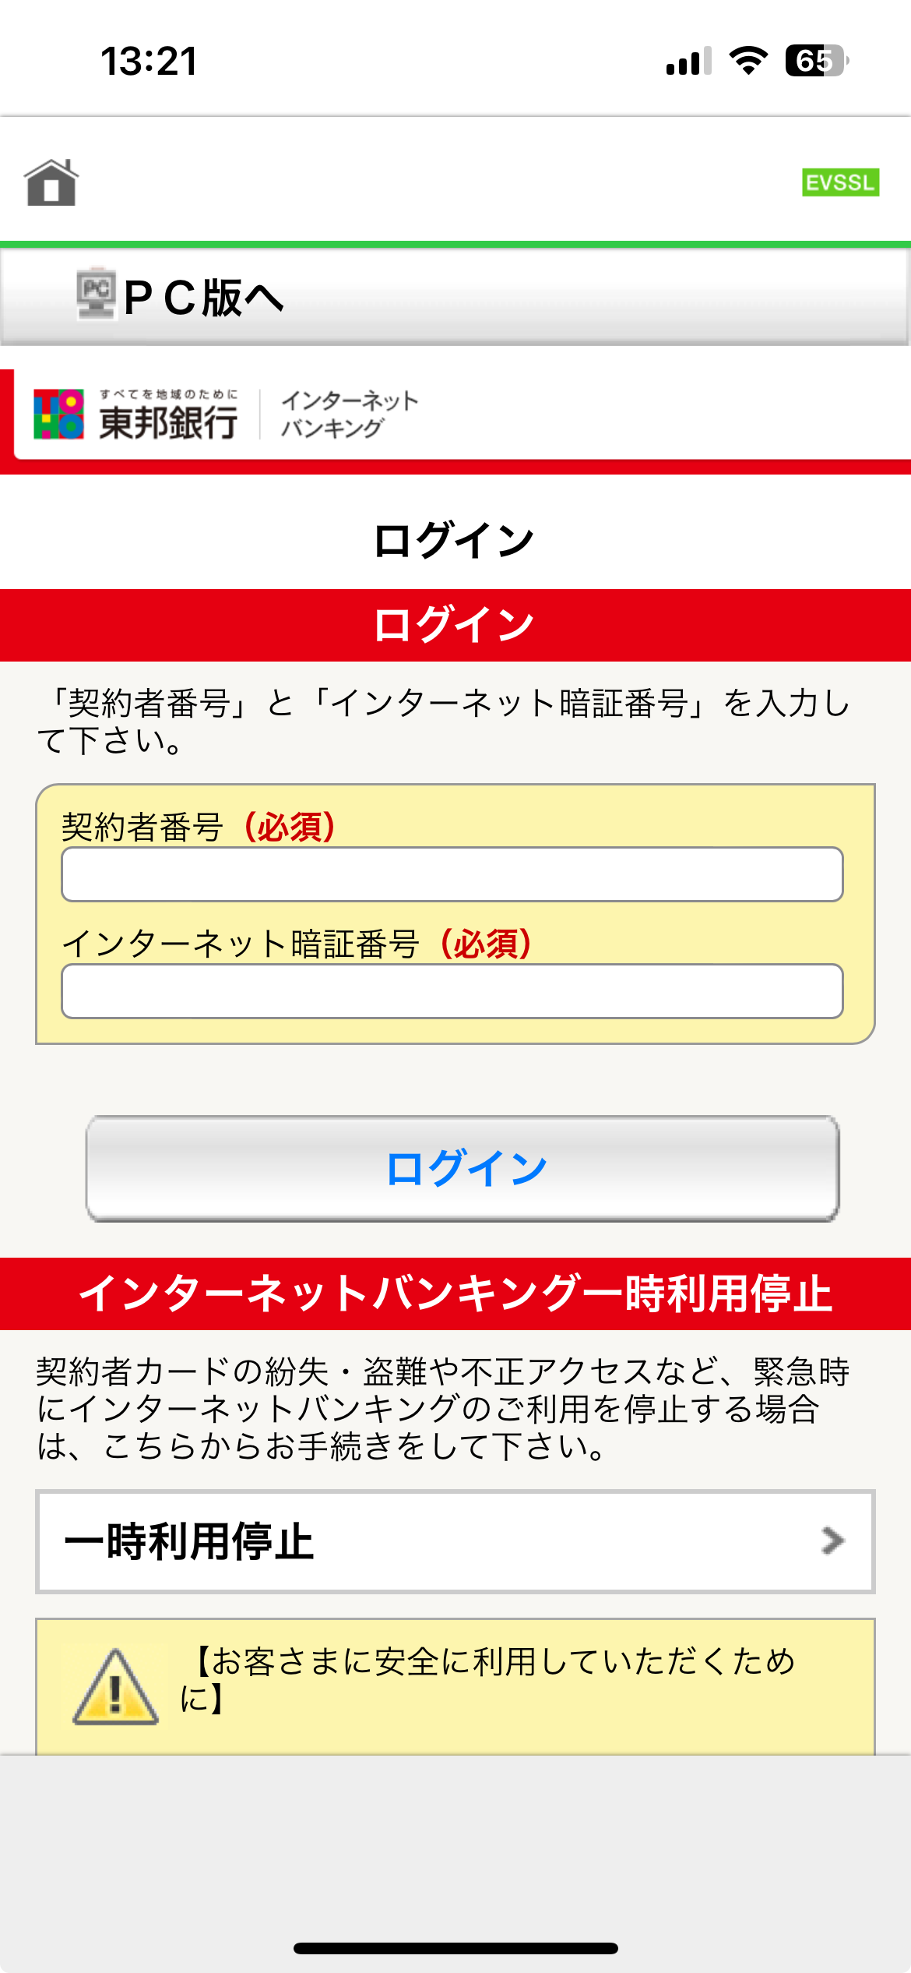
Press
Type Login ID
Type Password
activate FaceID authentication for future use
Press

Slide 2
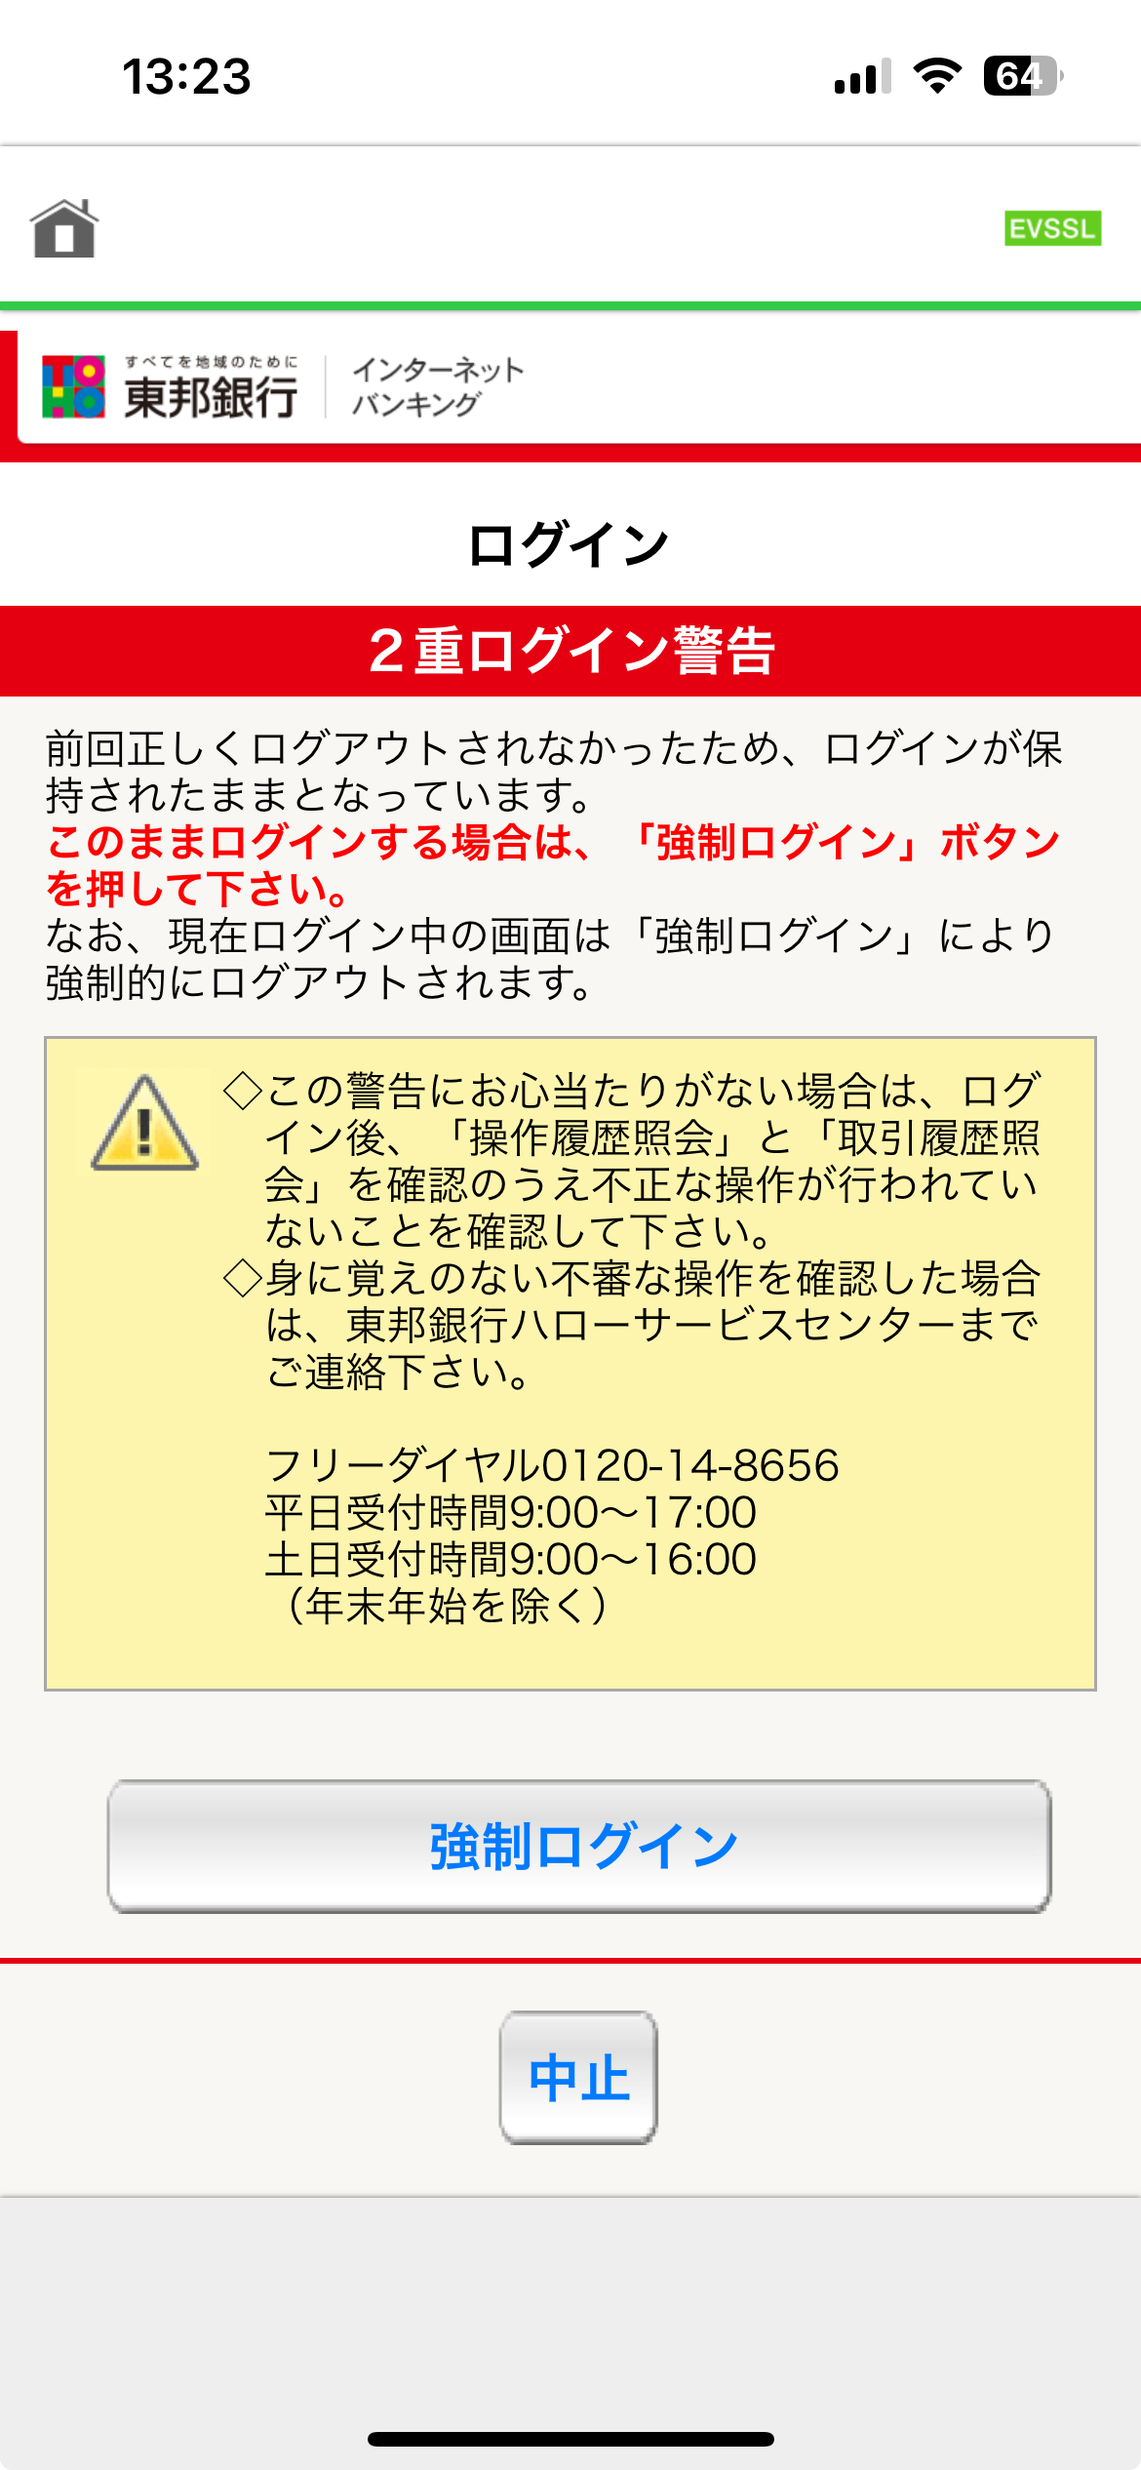
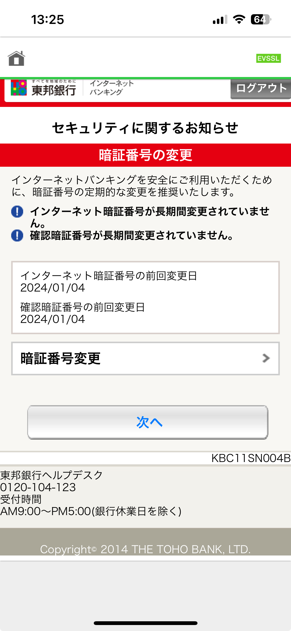
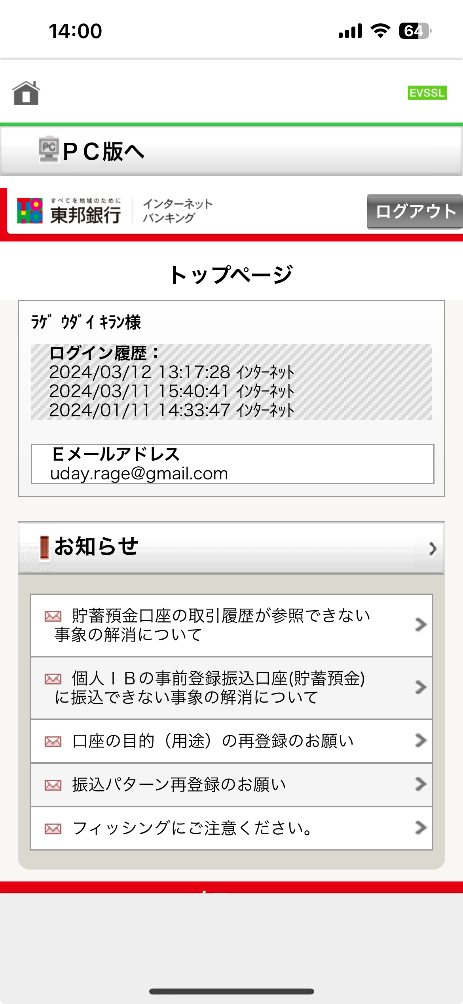
Scroll down
Press
Press
(Optional: You will see this screen, if you did not change password for sometime)

Slide 3
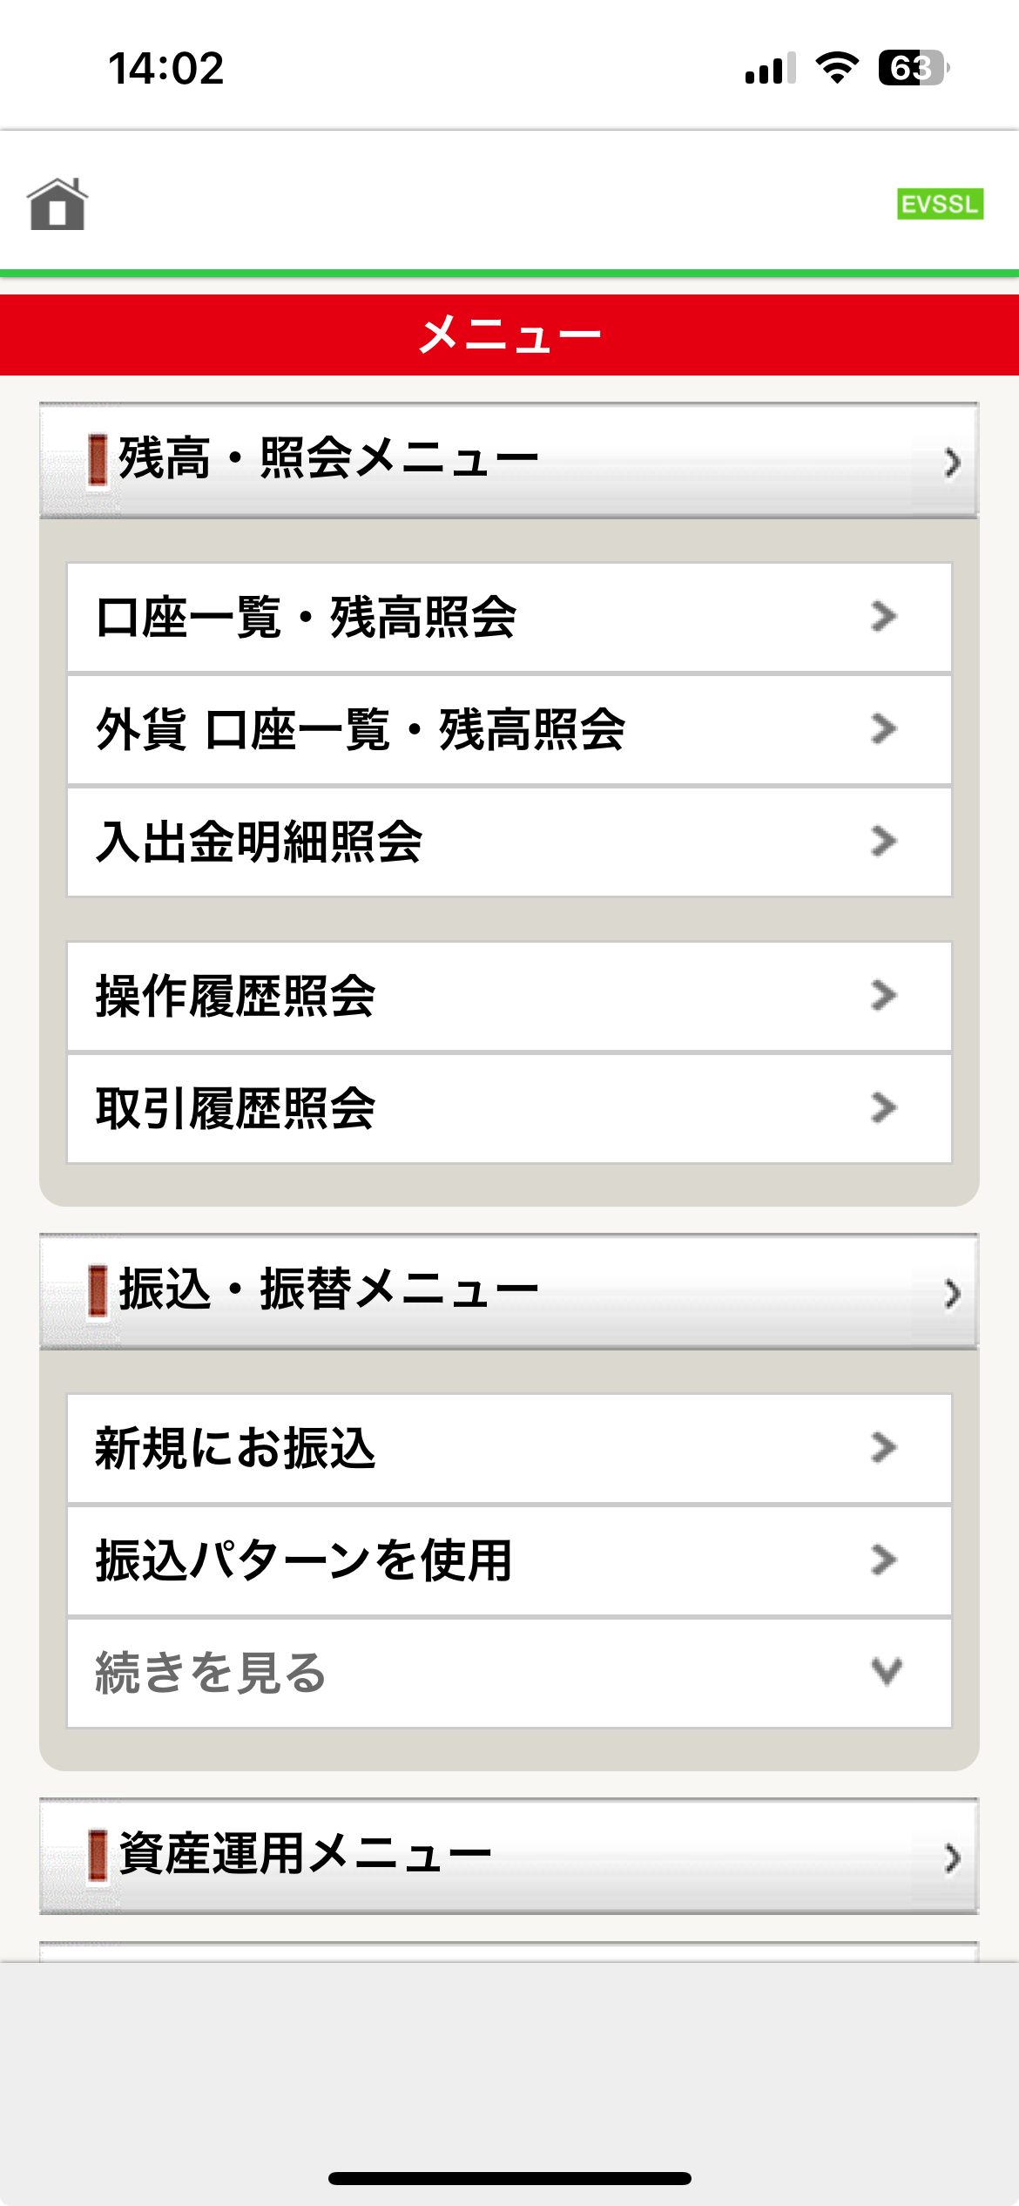
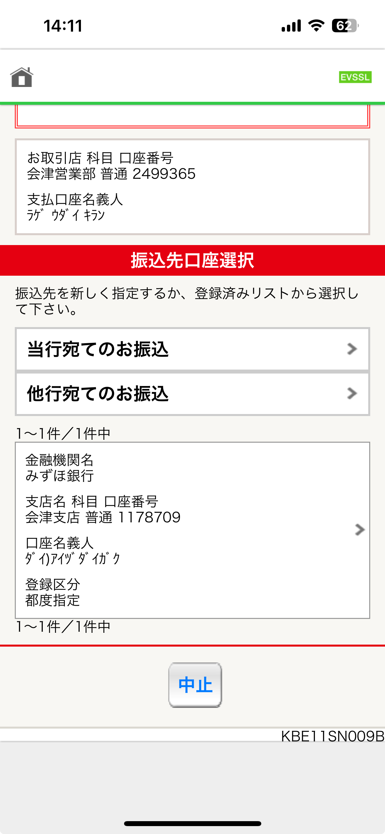
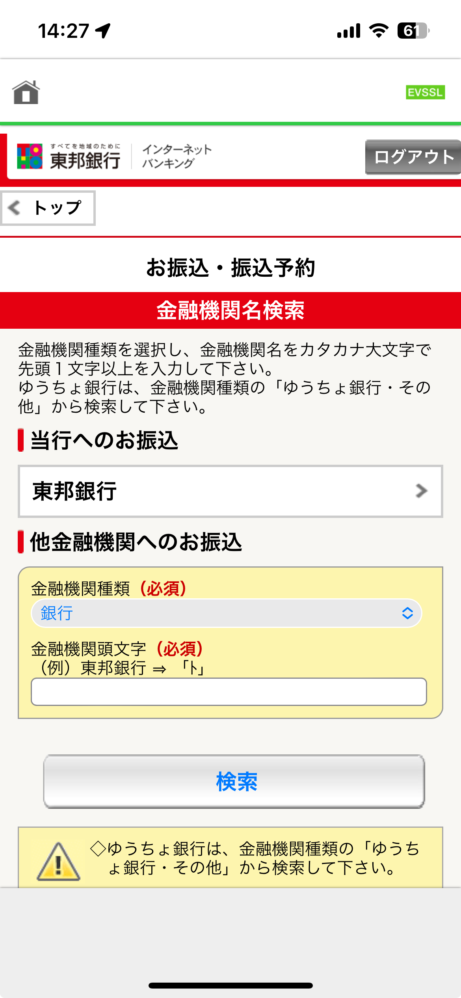
(transfer to Toho bank)
Press
(transfer to Another bank)
Press
Press

Slide 4
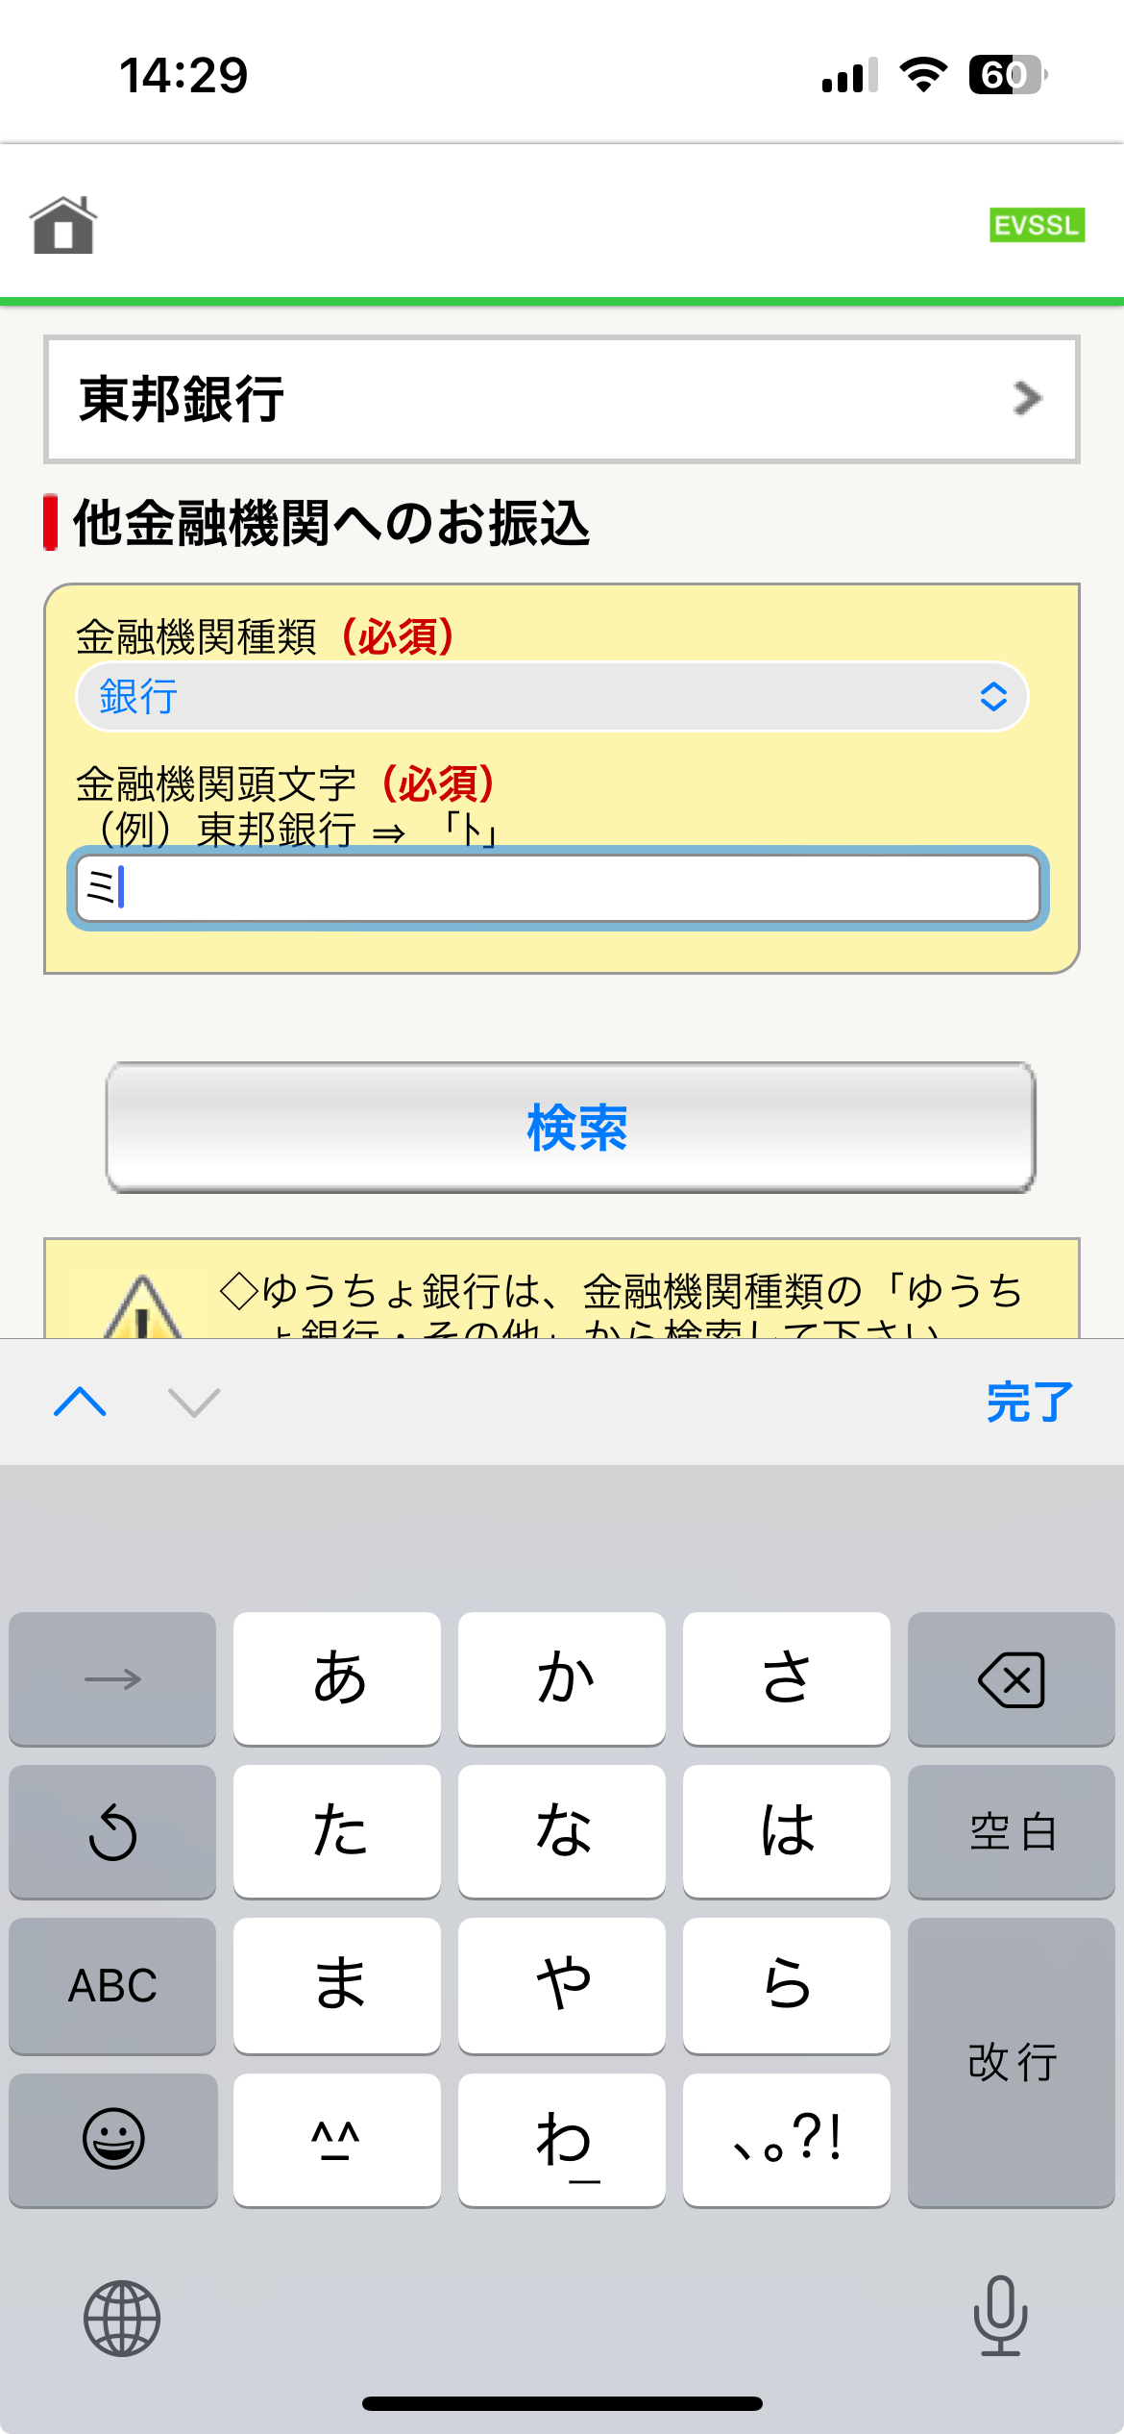
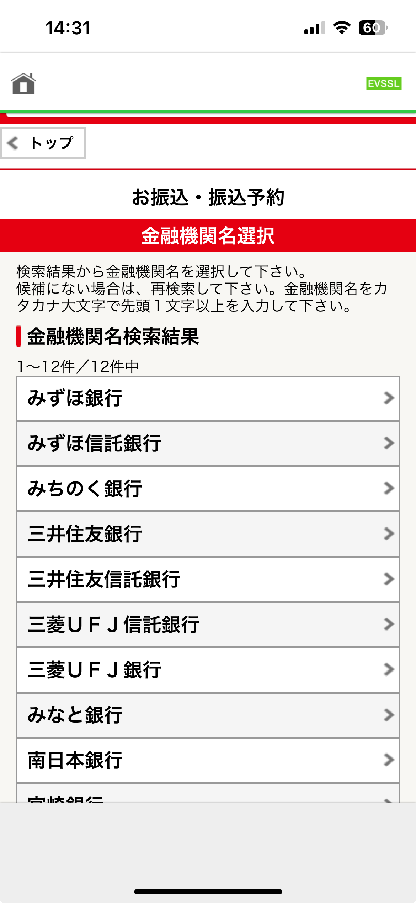
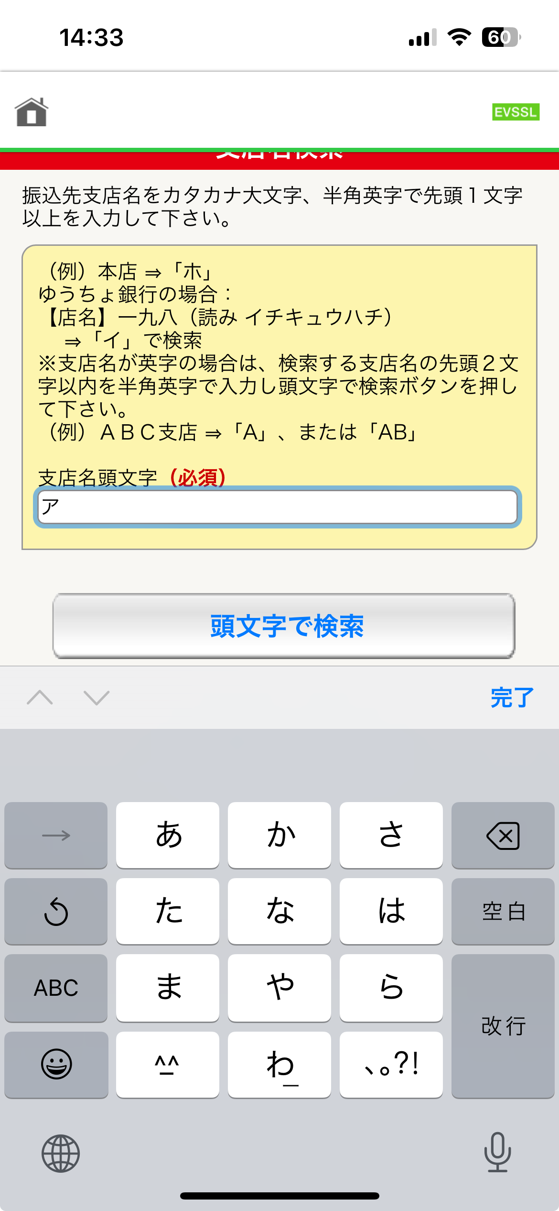
Step 1:
Using JP keyboard
enter first character
Choose
bank
(Mizuho)
Step 2:
Press
Step 1:
Enter the branch name
Step 2:
Press

Slide 5
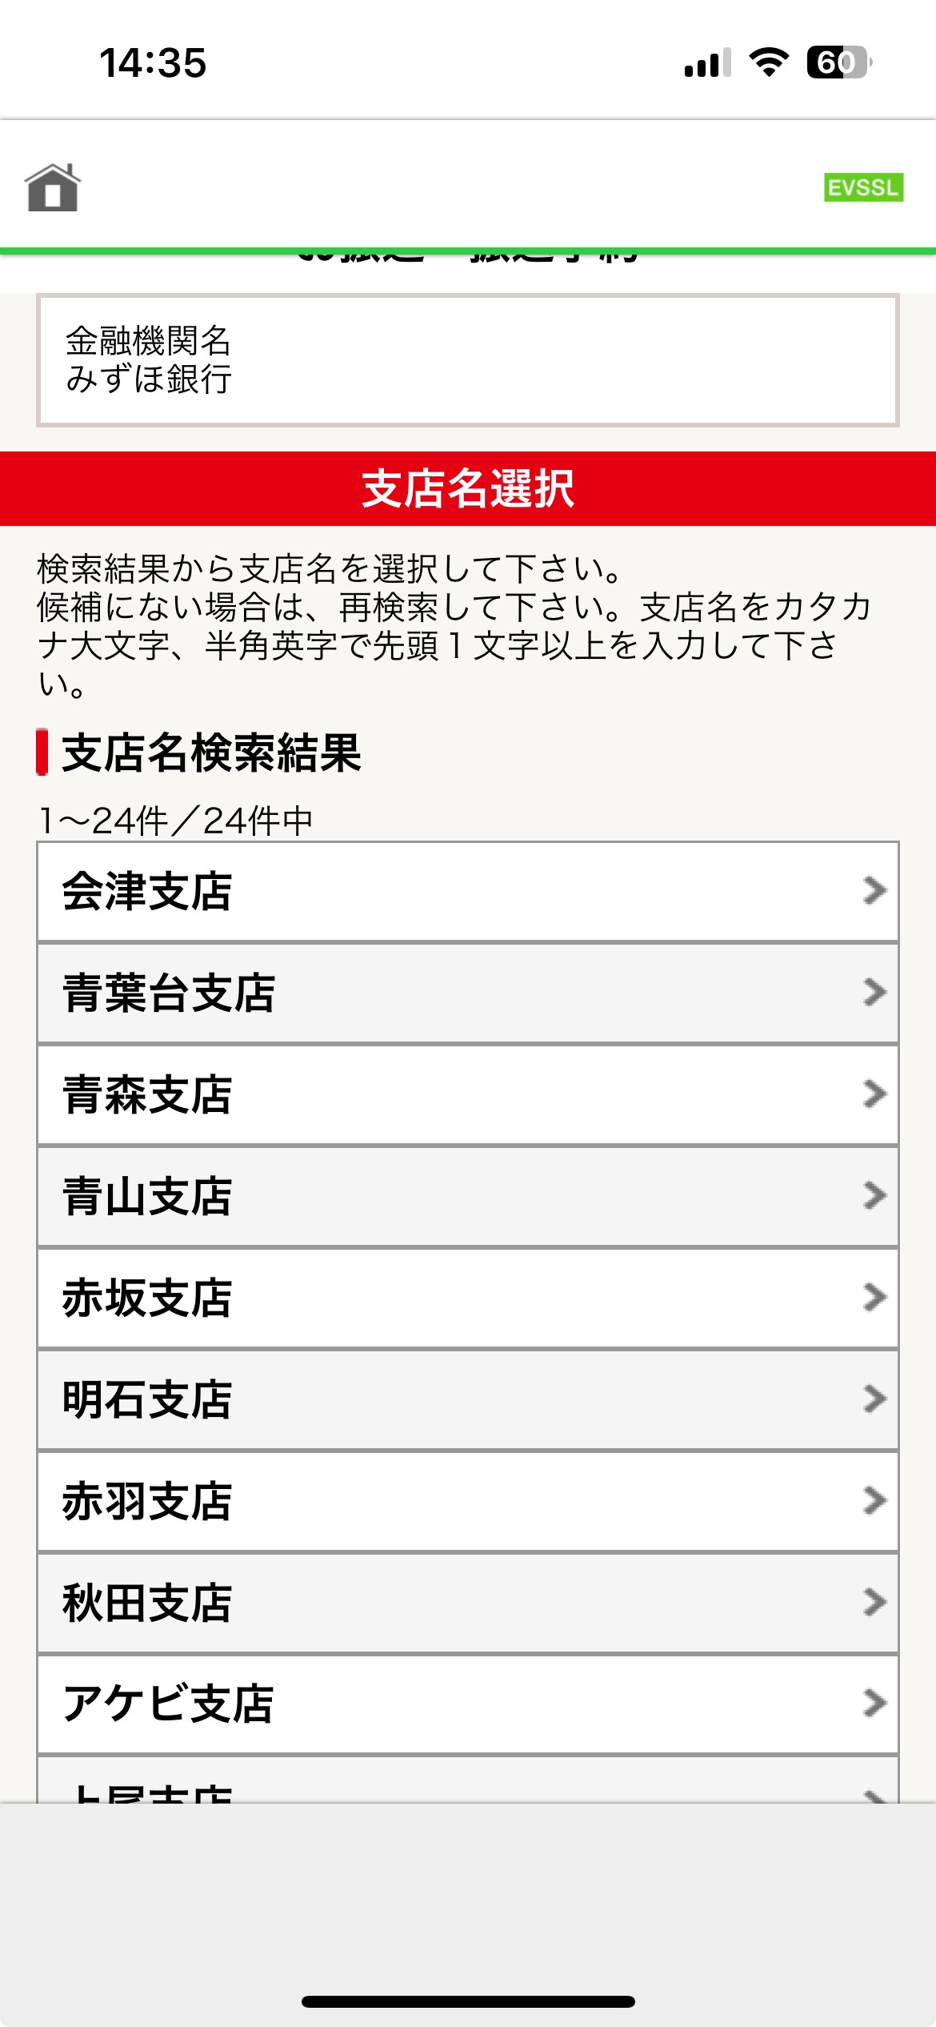
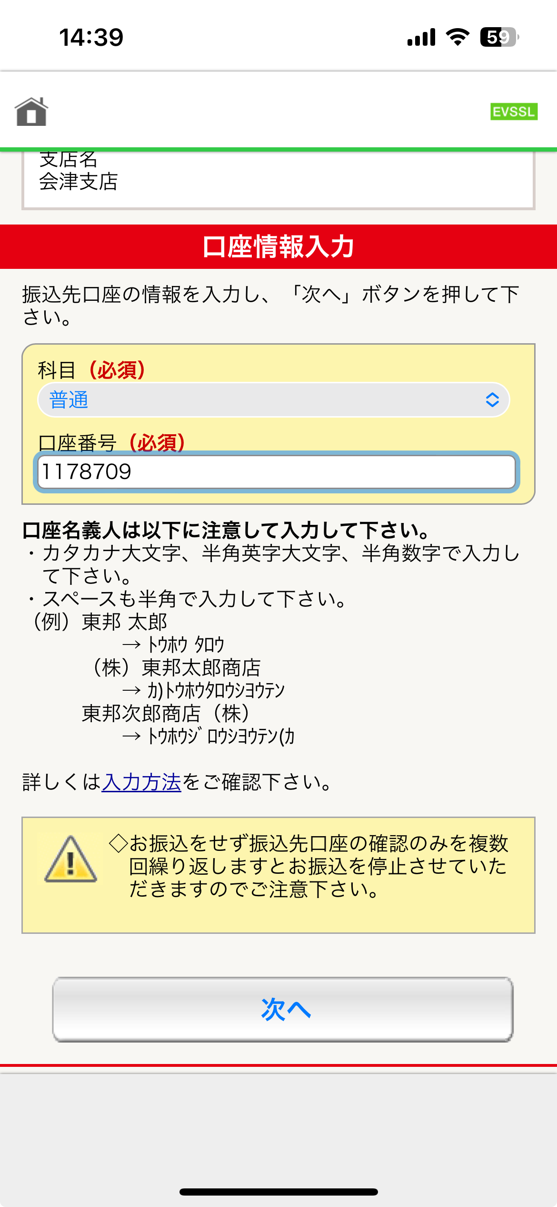
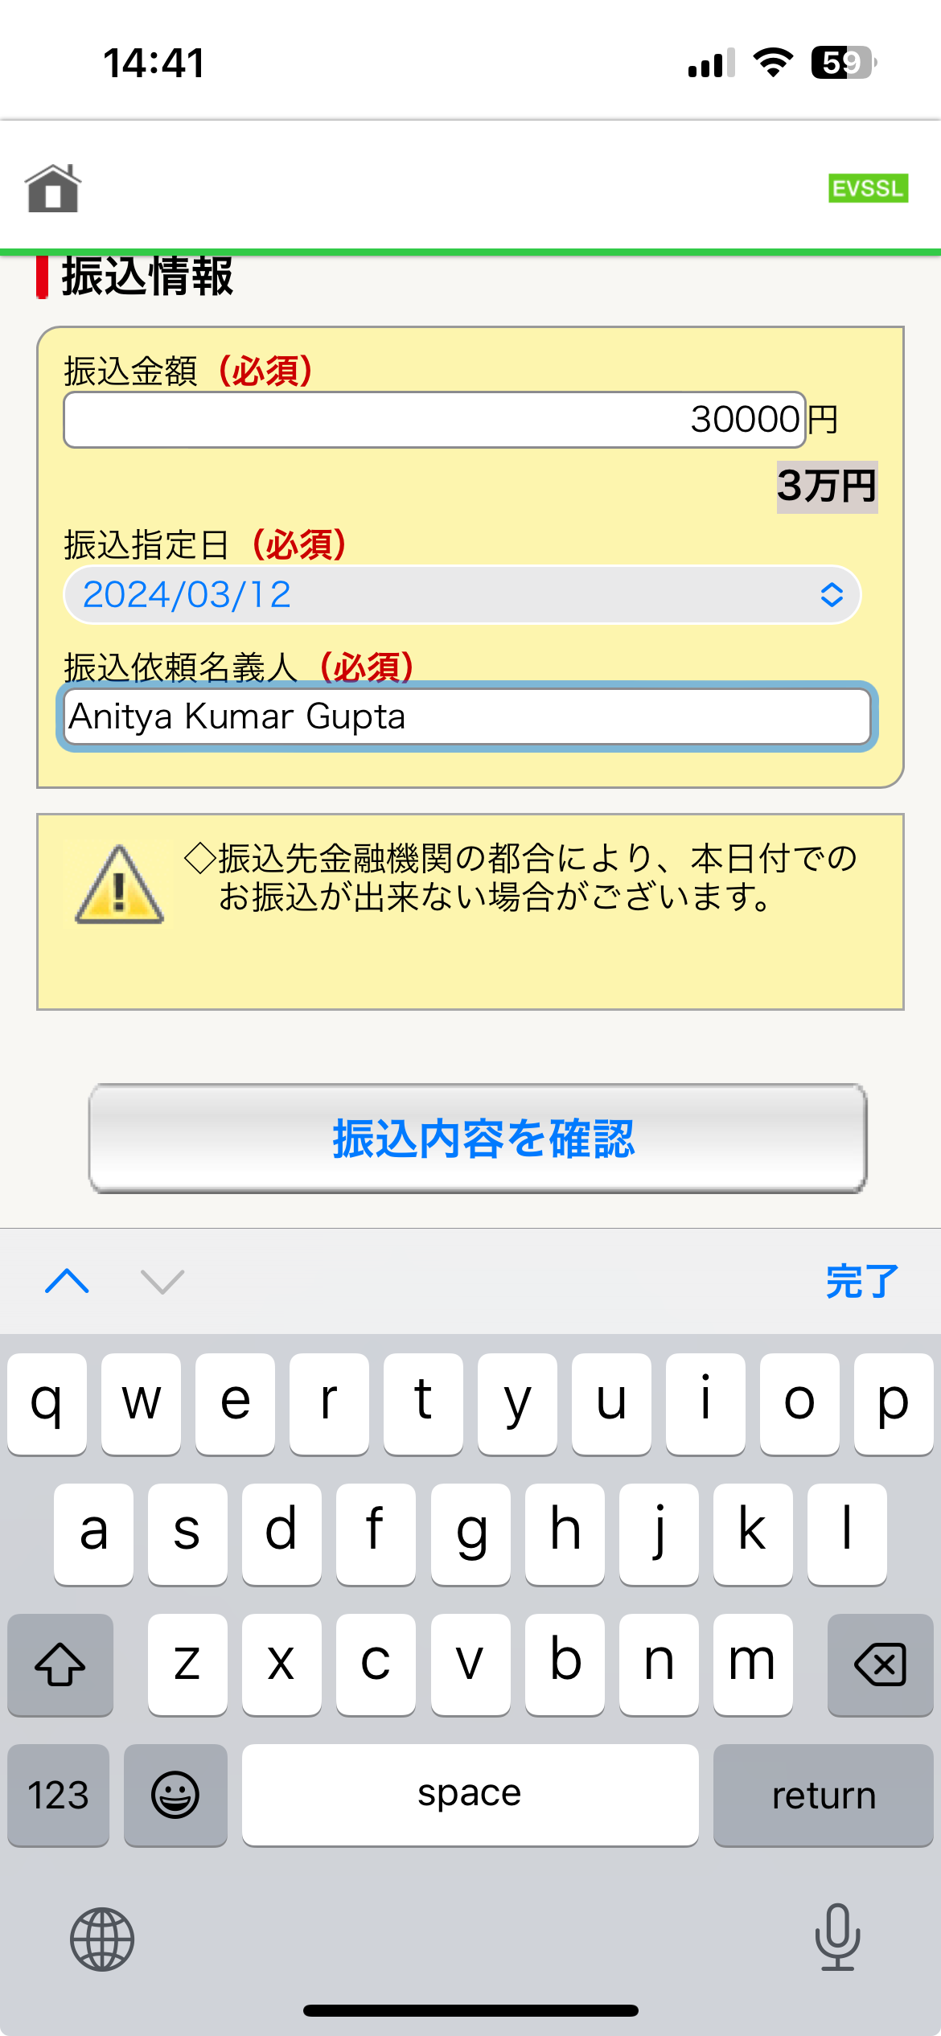
1. Type amount to send
1. Enter the account
number for whom money needs to be sent
Choose
branch
(Aizu main branch)
3. Press
2. Write the name of the sendor/person
2. Press

Slide 6
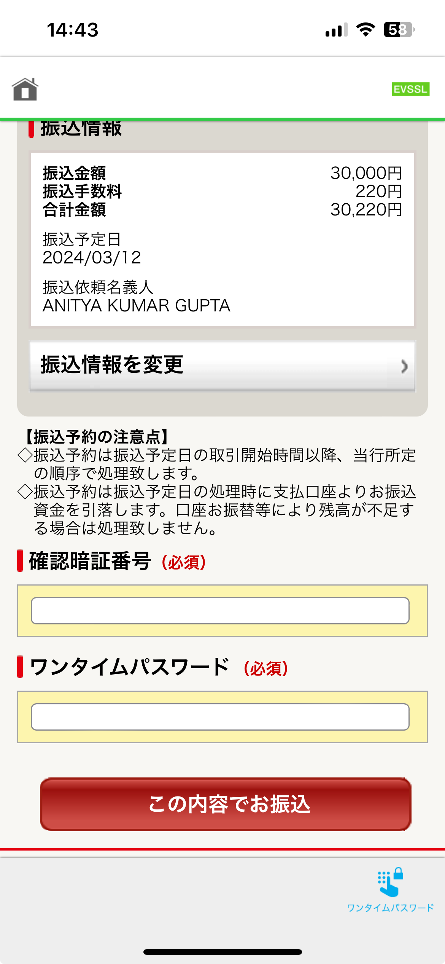
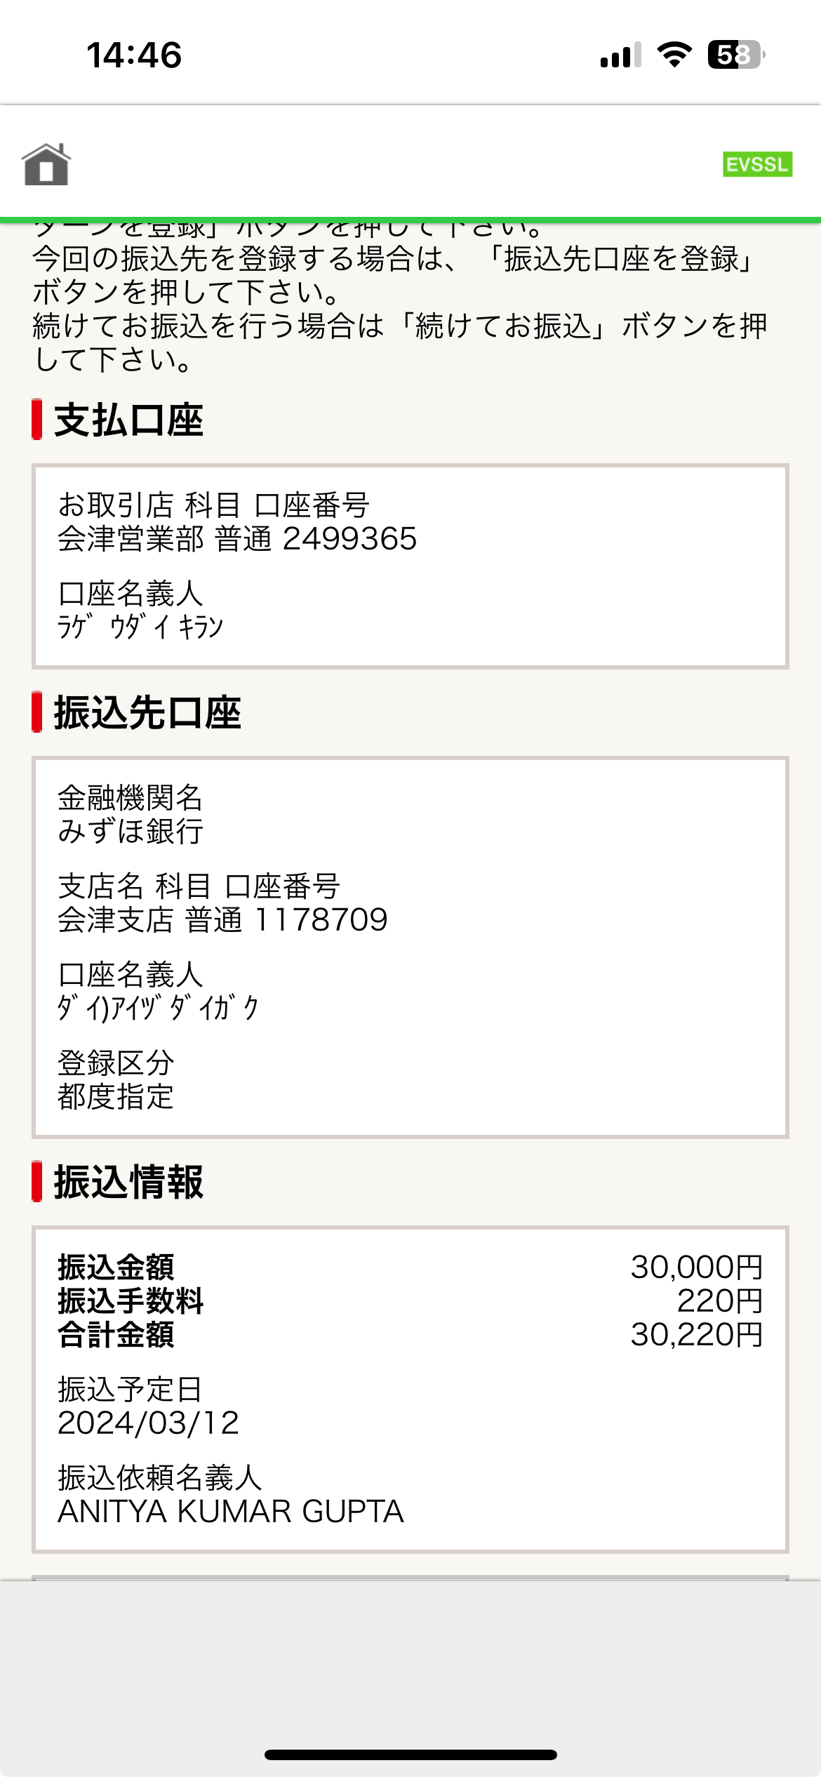
Final Screen.
Take screenshot
1. Enter the login password
(not pin number)
3. Random Numbers will appear here
4. Press the button to transfer money
2. Press this button

